Slide 1
IST718 Recommendation Systems
Willard Williamson
Adjunct Professor
iSchool, Syracuse University
linkedin.com/in/ncc-1701-d

Slide 2
Attendance
Please fill out the attendance sheet: https://docs.google.com/spreadsheets/d/1G5tiqXQn9mwyubWdINtPI_QONXH1_2U8oYikksgWlss/edit?usp=sharing
Write in a ‘1’ if you are present

Slide 3
Use case: A recommendation system
This problem seeks to find similarities between what a user or set of users have liked in the past with new items never seen before
This problem can be casted as an unsupervised learning approach if we seek to map high dimensional data into low dimensional data
Movies

Slide 4
Use case: a recommendation system
This problem seeks to find similarities between what a user or set of users have liked in the past with new items never seen before
This problem can be cast as an unsupervised learning approach if we seek to map high dimensional data into low dimensional data
Movies
Drama
Action

Slide 5
Use case: a recommendation system
This problem seeks to find similarities between what a user or set of users have liked in the past with new items never seen before
This problem can be cast as an unsupervised learning approach if we seek to map high dimensional data into low dimensional data
Movies
Ek Phool Do Mali
Drama
Fast and furious
Action

Slide 6
Use case: a recommendation system
This problem seeks to find similarities between what a user or set of users have liked in the past with new items never seen before
This problem can be cast as an unsupervised learning approach if we seek to map high dimensional data into low dimensional data
Fast and Furious not relevant because it is too far away
Movies
Releveant
Ek Phool Do Mali
Drama
Non-relevant
Fast and furious
Action

Slide 7
Use case: a recommendation system
Procedure:
Movie data starts out with many columns of feature data
Perform dimensionality reduction on the many columns of data thus reducing the number of columns
Group movies by user likes
Check what movies are close to the movies a user likes based on a distance function
The circle to the right shows the distance function.
Say a user likes “Good Will Hunting”, recommend the 2 other movies in the circle.
Ek Phool Do Mali
Drama
Good will
hunting
The Pianist
Action

Slide 8
Dimensionality reduction: why?
Performing nearest neighbor search in high dimensions is really hard.
Basically, the distance between close and far points becomes smaller and smaller as the number of dimensions increases!
See Beyer K., Goldstein J., Ramakrishnan R., Shaft U. (1999) When Is “Nearest Neighbor” Meaningful?
Example:
A unit ball from -1 to 1 in n dimensions
What happens to the volume of a ball as the number of dimensions increases?
https://en.wikipedia.org/wiki/Volume_of_an_n-ball

Slide 9
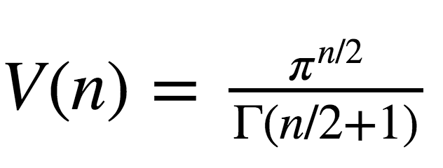
Unit Ball Volume vs. Num Dimensions
Notes:
https://en.wikipedia.org/wiki/Volume_of_an_n-ball

Slide 10
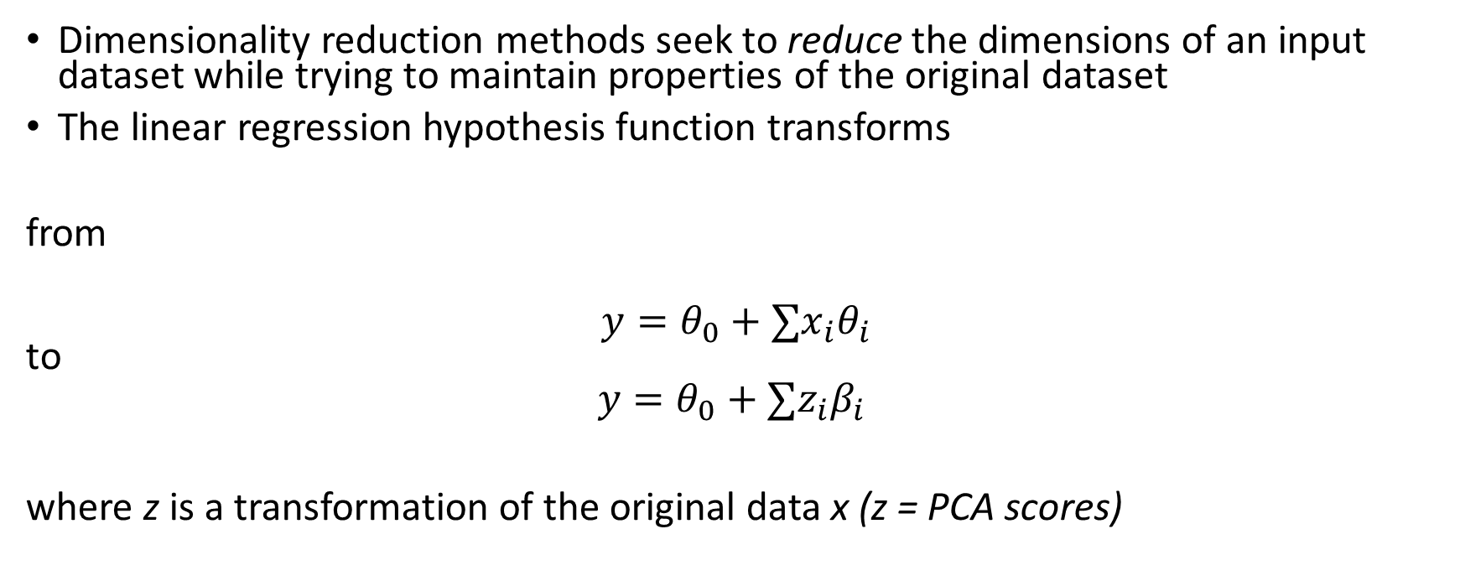
Dimensionality reduction
Dimensionality reduction methods seek to reduce the dimensions of an input dataset while trying to maintain properties of the original dataset
The linear regression hypothesis function transforms
from
$$y=θ_{0}+∑x_{i}θ_{i}$$ to
$$y=θ_{0}+∑z_{i}β_{i}$$
where z is a transformation of the original data x (z = PCA scores)

Slide 11
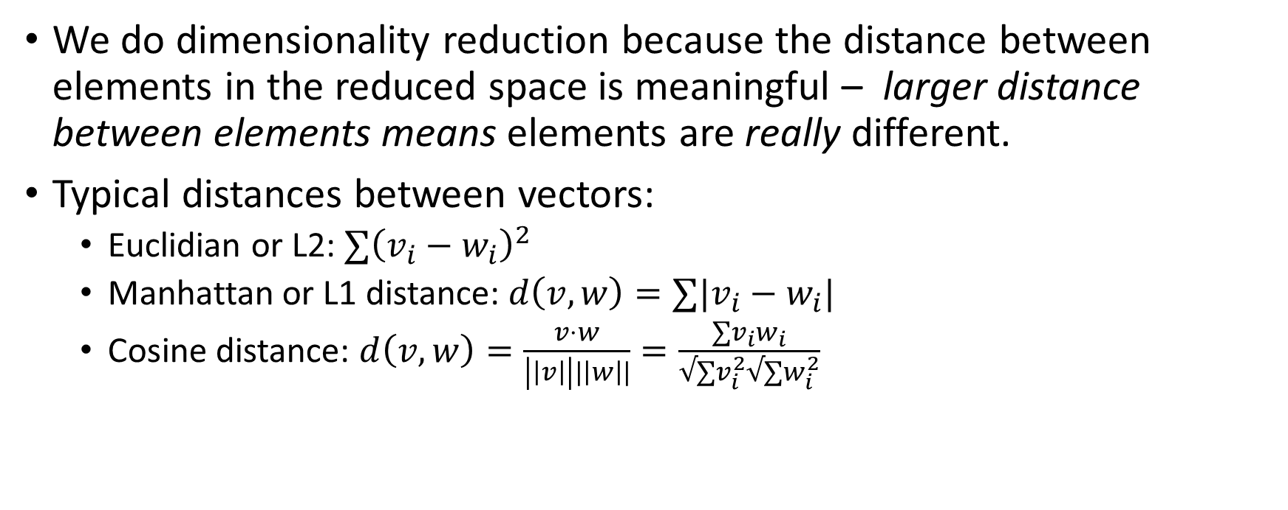
Dimensionality reduction
We do dimensionality reduction because the distance between elements in the reduced space is meaningful – larger distance between elements means elements are really different.
Typical distances between vectors:
Euclidian or L2: $∑{\left(v_{i}−w_{i}\right)}^{2}$
Manhattan or L1 distance: $d\left(v,w\right)=∑|v_{i}−w_{i}|$
Cosine distance: $d\left(v,w\right)=\frac{v⋅w}{\left|\left|v\right|\right||\left|w\right||}=\frac{∑v_{i}w_{i}}{√∑v_{i}^{2}√∑w_{i}^{2}}$

Slide 12
Principal Component Analysis
Produces a low dimensionality representation of the original data
Use PCA “scores” to represent lower dimensions of the original high dimension data
Use the PCA “loadings” to gain insight about the lower dimensionality representation (inference) using tools such as the biplot
Each principal component loading vector captures a fraction of the dataset variance.
The highest variance typically offers the highest predictive value

Slide 13
Why is variance important in data science?
Horsepower | Num Cylinders | Miles Per Gallon
200 | 8 | 32
250 | 8 | 28
300 | 8 | 22
400 | 8 | 19
450 | 8 | 16
In the made up dataset above, we try to predict miles per gallon based number of cylinders, and horsepower.
The number of cylinders has 0 variance so it offers no predictive value to the miles per gallon.
However, horsepower has variance and can be used to predict miles per gallon.

Slide 14

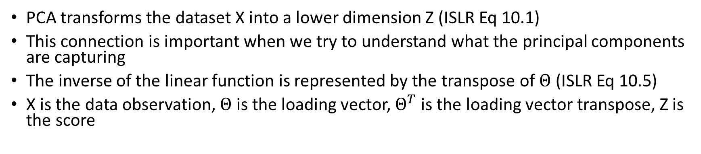
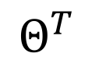
PCA Transform and Inverse Transform
PCA transforms the dataset X into a lower dimension Z (ISLR Eq 10.1)
This connection is important when we try to understand what the principal components are capturing
The inverse of the linear function is represented by the transpose of $Θ$ (ISLR Eq 10.5)
X is the data observation, $Θ$ is the loading vector, $Θ^{T}$is the loading vector transpose, Z is the score
$$Θ$$
x
z
$$Θ^{T}$$

Slide 15
Apply PCA transform and inverse transform to MNIST digit dataset

Slide 16
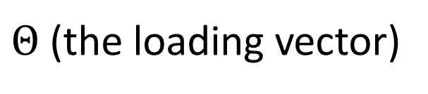
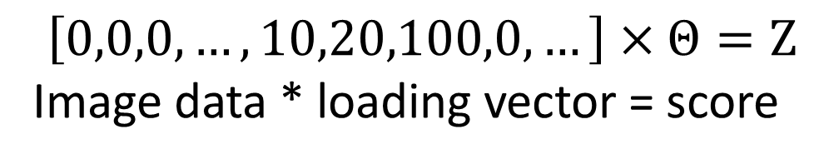
Example: MNIST digit dataset
$Θ$ (the loading vector)
X = 64-dim vector
(a row in the data set)
The score
PC 1 (loading vector
direction)
$$\left[0,0,0,…,10,20,100,0,…\right]×Θ=Z$$
Image data * loading vector = score

Slide 17

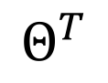
Example: MNIST digit dataset
$$Θ$$
X = 64-dim vector
PC 1
-0.92867
X’ = 64-dim vector
PC 1
$$Θ^{T}$$

Slide 18
Example: MNIST digit dataset
$$Θ$$
X = 64-dim vector
PC 1
-0.92867
X’ = 64-dim vector
PC 1
$$Θ^{T}$$

Slide 19
Example: MNIST digit dataset
$$Θ$$
X = 64-dim vector
PC 1
8.288
X’ = 64-dim vector
PC 1
$$Θ^{T}$$

Slide 20
Example: Using 1 PC

Slide 21
Example: Using 2 PC

Slide 22
Example: Using 3 PC

Slide 23
Example: Using 4 PC

Slide 24
Example: Using 10 PC

Slide 25
Example: Using 20 PC

Slide 26
Example: Using 30 PC

Slide 27
Example: Using 40 PC

Slide 28
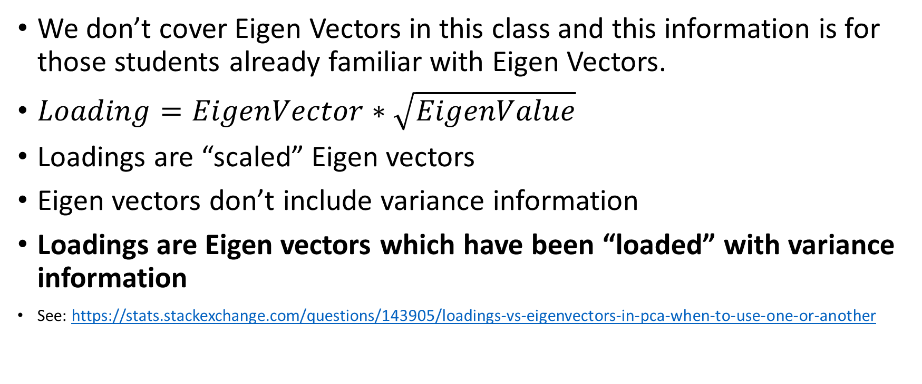
Loading Vectors vs. Eigenvectors
We don’t cover Eigen Vectors in this class and this information is for those students already familiar with Eigen Vectors.
$Loading=EigenVector∗\sqrt{EigenValue}$
Loadings are “scaled” Eigen vectors
Eigen vectors don’t include variance information
Loadings are Eigen vectors which have been “loaded” with variance information
See: https://stats.stackexchange.com/questions/143905/loadings-vs-eigenvectors-in-pca-when-to-use-one-or-another

Slide 29
PCA Standardization / Centering Best Practice
Always need to compute zero mean (centering) on per column basis
If the data is already in the same units, standardizing (dividing by the column standard deviation) can throw away information
If data is all in same units, best not to standardize, center only. Ex: TF-IDF data

Slide 30
Loading Vector Inference
Given that the loading vector coefficients represent either correlation or covariance, we can use this information for inference
Example:
Use loading vector coefficient to determine feature importance.
Feature with the most positive loading vector coefficient for a standardized dataset represents the highest positive correlation between the loading vector and variable
Feature with the most positive covariance for a centered (only centered) dataset represents the highest positive covariance between the loading vector and variable (assuming all units are the same in the dataset)

Slide 31
How to interpret PCA data
If the variables were standardized, loading vector coefficients represent the amount of correlation between the loading vector and the predictor variables.
If only zero mean was computed, the loading vector coefficients represent the amount of covariance between the loading vector and the predictor variables.
See: https://stats.stackexchange.com/questions/463151/how-to-interpret-loadings-and-eigenvectors-in-pca/463181#463181

Slide 32
K-Means and Data Scaling
Scaling data can help K-Means form clusters that are immune from different units in the data.
If you have attributes with a well-defined meaning. Say, latitude and longitude, then you should not scale your data, because this will cause distortion.
If you have mixed numerical data, where each attribute is something entirely different (say, shoe size and weight), then the clustering process could benefit by scaling the data.
Standardization or normalization can both be used to scale the data.
https://stats.stackexchange.com/questions/89809/is-it-important-to-scale-data-before-clustering

Slide 33
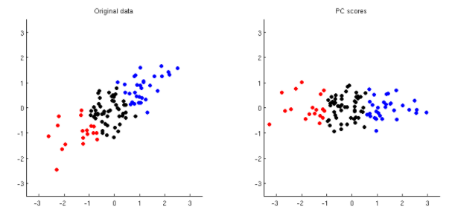
K-Means and PCA
PCA performs a data rotation which does not change Euclidean distance between points.
This means that K-Means or other clustering algorithms can be performed before or after PCA analysis
See https://stats.stackexchange.com/questions/230319/why-are-the-cluster-analysis-results-using-raw-data-the-same-as-the-ones-using-p
The plot below shows how PCA rotates the data.
Euclidian distance remains the same
PC Score
Data Value
Data Value
PC Score

Slide 34
How to plot K-Means Clusters
Problem: If you compute more than 3 cluster assignments, how do you plot the clusters?
Solution, use PCA to project the data into a lower dimensional space to plot the points.
Example:
Compute cluster assignments on PCA scores or original data
For each row of data, plot the data in 2 dimensions or 3 dimensions using the first 2 or 3 principal component score data to locate the points on the scatter plot.
Color the points by cluster assignment

Slide 35
Recommender System Demo ipynb

Slide 36
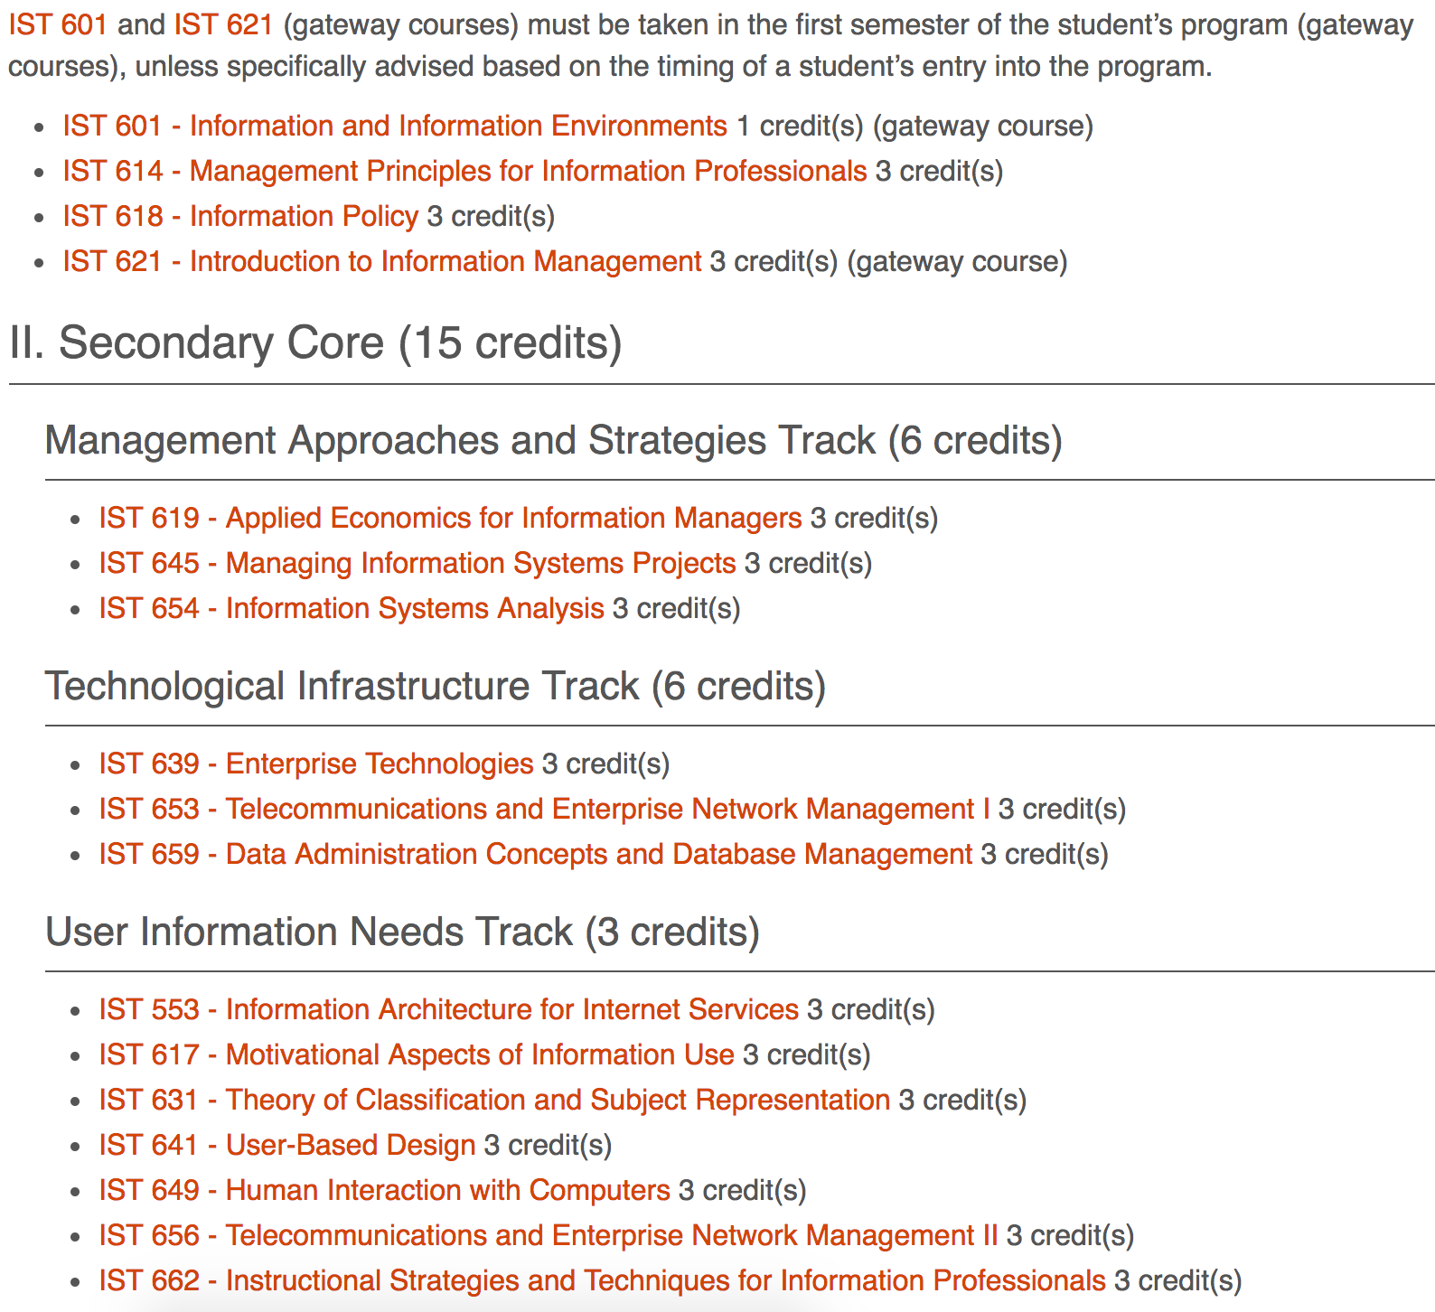

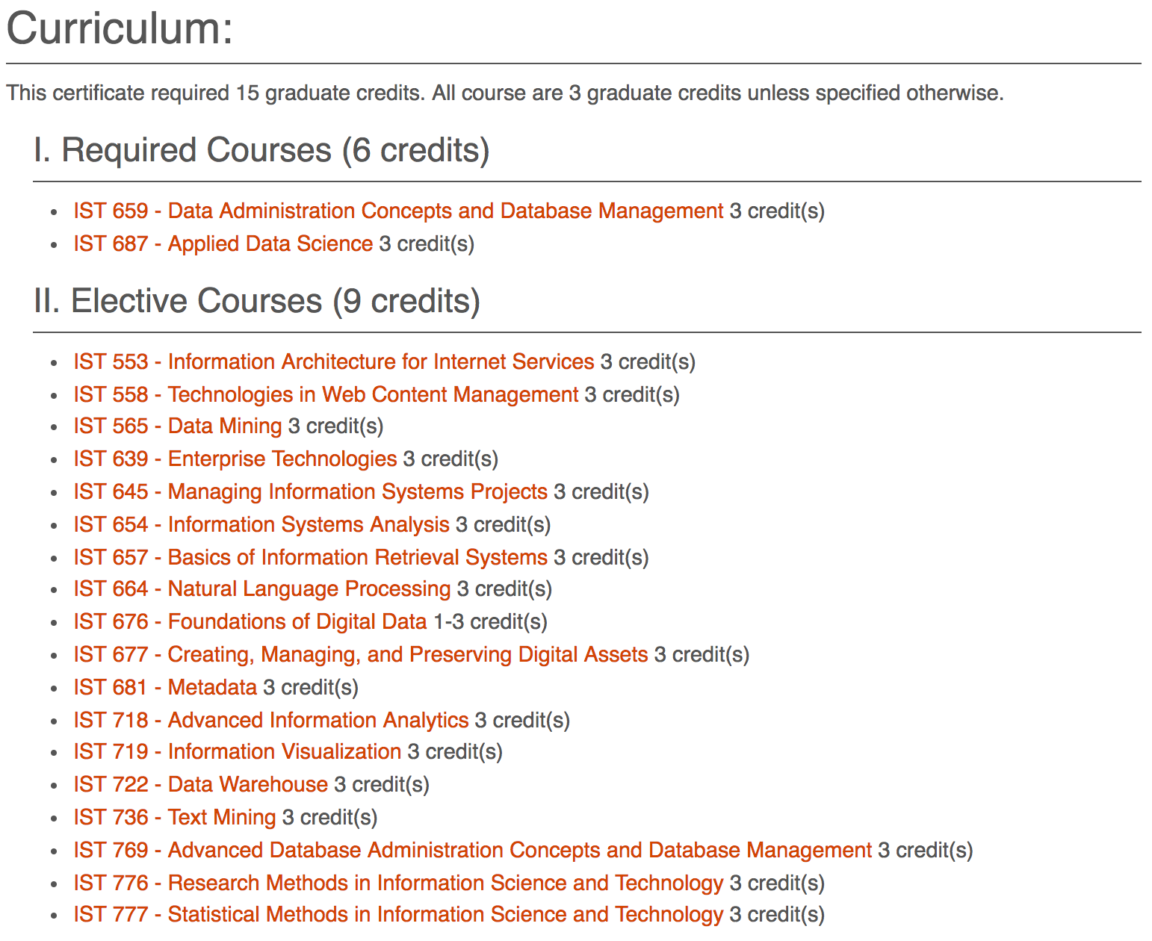
Ipynb Code Demo

Slide 37
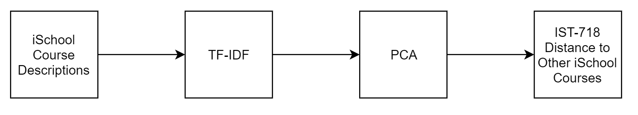
Ipynb Code DemoBlock Diagram

Slide 38
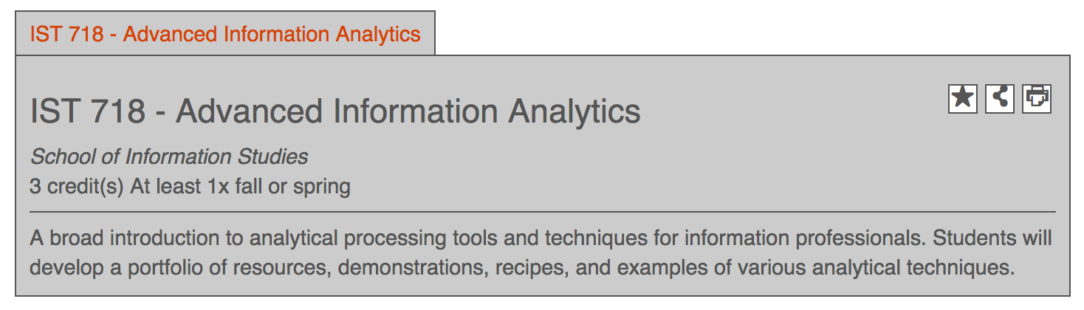
Ipynb Code Demo
Apply dimensionality reduction and suggest based on nearest neighbors in lower dimension

Slide 39
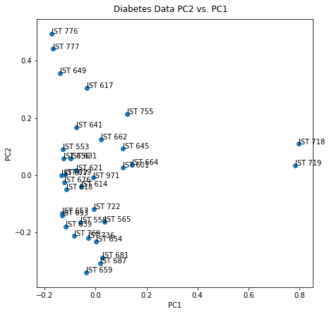
Ipynb Code Demo
Use PCA on TFIDF matrix to map courses to a low dimensional space

Slide 40
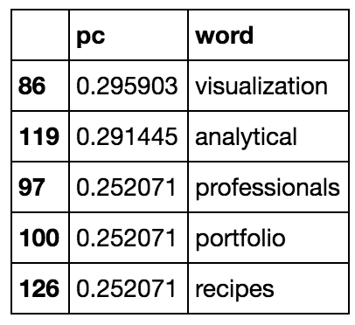
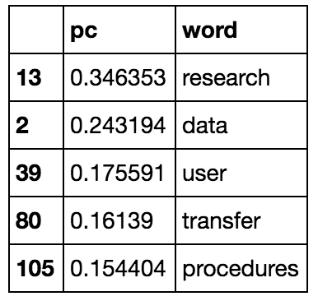
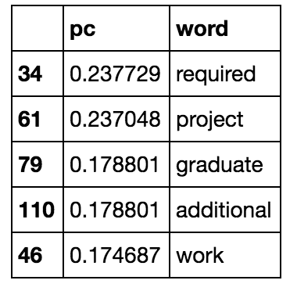
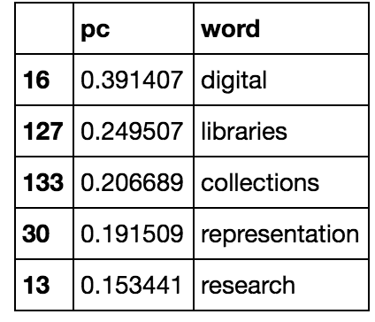
Biggest absolute loadings of PCA
Absolute value of loadings
PC 1
PC 2
PC 3
PC 4
Any interpretation?

Slide 41
Improvement Idea: Compute distance on multiple course factors
Transform course description to TF-IDF
Use PCA on TF-IDF to reduce dimensionality of the TF-IDF matrix
Compute similarity between IST-718 and other courses in the course catalog
Other features like student course reviews could possibly be added to the feature columns (only course description TF-IDF is used in the example recommendation system notebook)
description
PCA of TF-IDF
[0.1, 0.2, -0.5, …]
Other possible features

Slide 42
Improvement Idea: Compute distance on multiple course factors
The example below shows how we might define a similarity function using TF-IDF on the description, and 3 other factors: Level 1, level 2, and level 3 where the levels could represent other course characteristics like the student reviews of the course.
Description space
Level 1 space
Level 2 space
Level 3 space
IST 718
IST 718
IST 718
IST 718
IST 617
IST 617
IST 617
IST 617
$$D\left(a,b\right)=αD_{description}\left(a,b\right)+βD_{level1}\left(a,b\right)+γD_{level2}\left(a,b\right)+η D_{level3}(a,b)$$

Slide 43
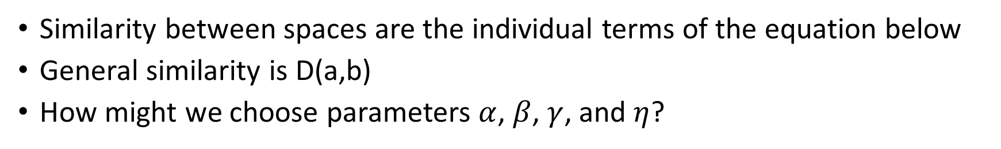
Idea: Define a similarity function between spaces and a general similarity function
Similarity between spaces are the individual terms of the equation below
General similarity is D(a,b)
How might we choose parameters $α$, $β$, $γ$, and $η$?
$$D\left(a,b\right)=αD_{description}\left(a,b\right)+βD_{level1}\left(a,b\right)+γD_{level2}\left(a,b\right)+η D_{level3}(a,b)$$

Slide 44
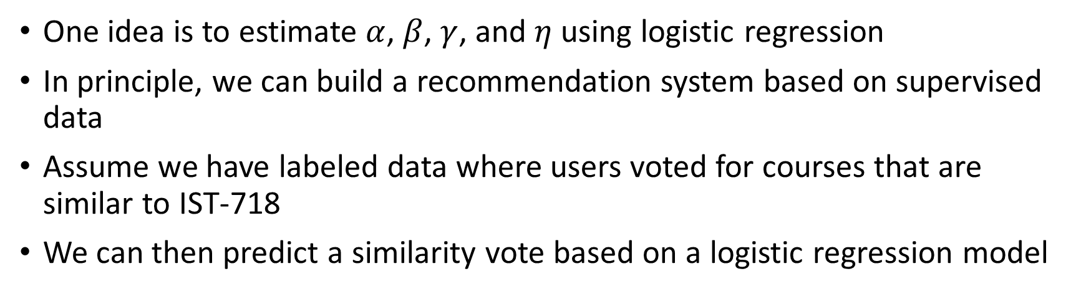
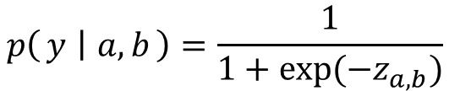
Using logistic regression to suggest courses
One idea is to estimate $α$, $β$, $γ$, and $η$ using logistic regression
In principle, we can build a recommendation system based on supervised data
Assume we have labeled data where users voted for courses that are similar to IST-718
We can then predict a similarity vote based on a logistic regression model
$$z_{a,b}=αD_{description}\left(a,b\right)+βD_{level1}\left(a,b\right)+γD_{level2}\left(a,b\right)+η D_{level3}(a,b)$$
$$p\left(y ∣ a,b\right)=\frac{1}{1+exp⁡(−z_{a,b})}$$

Slide 45
Attendance
Please fill out the attendance sheet: https://docs.google.com/spreadsheets/d/1G5tiqXQn9mwyubWdINtPI_QONXH1_2U8oYikksgWlss/edit?usp=sharing
Write in a ‘1’ if you are present

